Slide 1
Tobias A. Kroll | Ana Honnacker | Chris Townsend
Pragmatic humanism in CSD: engaging rural, White students in diversity education
2021 ANNUAL CAPCSD CONFERENCE
April 8, 2021 | 10-11am ET

Slide 2
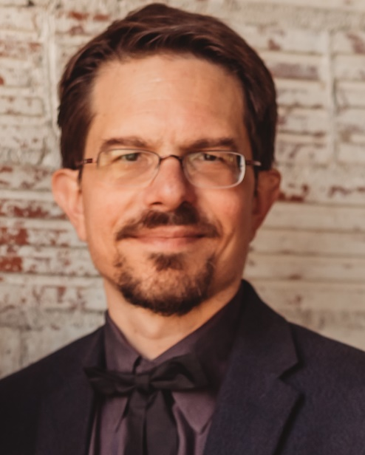
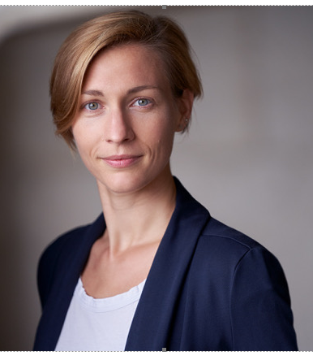
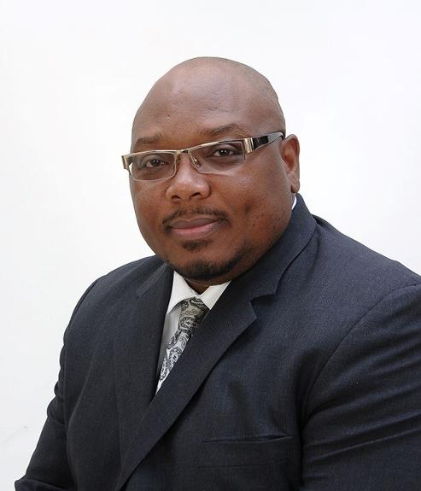
Your presenters
Tobias A. Kroll, PhD, CCC-SLP
TTUHSC Speech, Language & Hearing
tobias.kroll@ttuhsc.edu
Ana Honnacker, Dr. Phil.
Institute for Philosophy
University of Hildesheim, Germany
post@ana-honnacker.de
Chris Townsend, PhD, LPC, LCAS, CCS, NCC
TTUHSC Mental Health & Counseling
chris.townsend@ttuhsc.edu

Slide 3
Disclosures
All of us work in institutions of higher education that pay us for this work
Ana has written a book that is our primary reference

Slide 4
Goal
Post summer 2020, a robust push for anti-racist work in CSD and CSD teaching
Our goal: a note of caution and a suggestion
Caution: re: critical theory as main framework
Suggestion: pragmatic humanism

Slide 5
Learner outcomes
Describe the difference between critical theory and pragmatic humanism
Outline the difficulties of using a critical theory framework, especially when teaching an overwhelmingly White, rural student body
Use three concrete strategies to couch CSD diversity education in an interpretive framework that takes White, rural students’ culture into account

Slide 6
Agenda
Racism & CSD diversity education
Critical theory
Pragmatic humanism
A Q&A with a Black educator & counselor

Slide 7
1. Racism & CSD diversity education

Slide 8
Some key terms
Racism
BIPOC
“I don’t like _____ people.”

Slide 9
“Racism”—scholarly definition: White supremacy
more
White people (European ancestry)
People of color
Black people (African, Australian, Melanesian ancestry)
Hierarchy of human worth
Indigenous people
less

Slide 10
The timeline of “white supremacy”
White supremacy: economic, social, cultural, ideological, legal reality
Lingering aftermath
Notes:
Well, it’s complicated. We all come from a racist past, and those ideas and ideologies don’t just go away. They stick with us. We are products of our pasts, after all.

Slide 11
Ramifications of lack of diversity in CSD
Racial disparities in healthcare at large (e.g. Egede, 2006), CSD (e.g. Robinson & Norton, 2019)
Issues in communication, rapport building, cultural competence & humility
e.g. ASHA, n. d.; Johnson, Roter et al., 2004; Johnson, Saha et al., 2004; Shen et al., 2018; Spooner et al., 2016; Tervalon & Murray-García, 1998
Need for more diverse workforce
Need for diversity education

Slide 12
Political leanings in one rural-area CSD program
TTUHSC SLHS Class of 2021
TTUHSC SLHS Class of 2020
Tendency: “colorblind”, patriotic, conflict-averse

Slide 13
The issue with diversity education
Current discourse as seen from the center-right:
Why is so much diversity training radical and weird?
French, 2020

Slide 14
2. Critical theory

Slide 15
Critical theory
Horkheimer & Adorno (1947)
Adorno (1951)
Max Horkheimer (1895-1973)
© J. Shapiro (1964) under Creative Commons; picture cropped
Theodor W. Adorno (1903-1969)

Slide 16
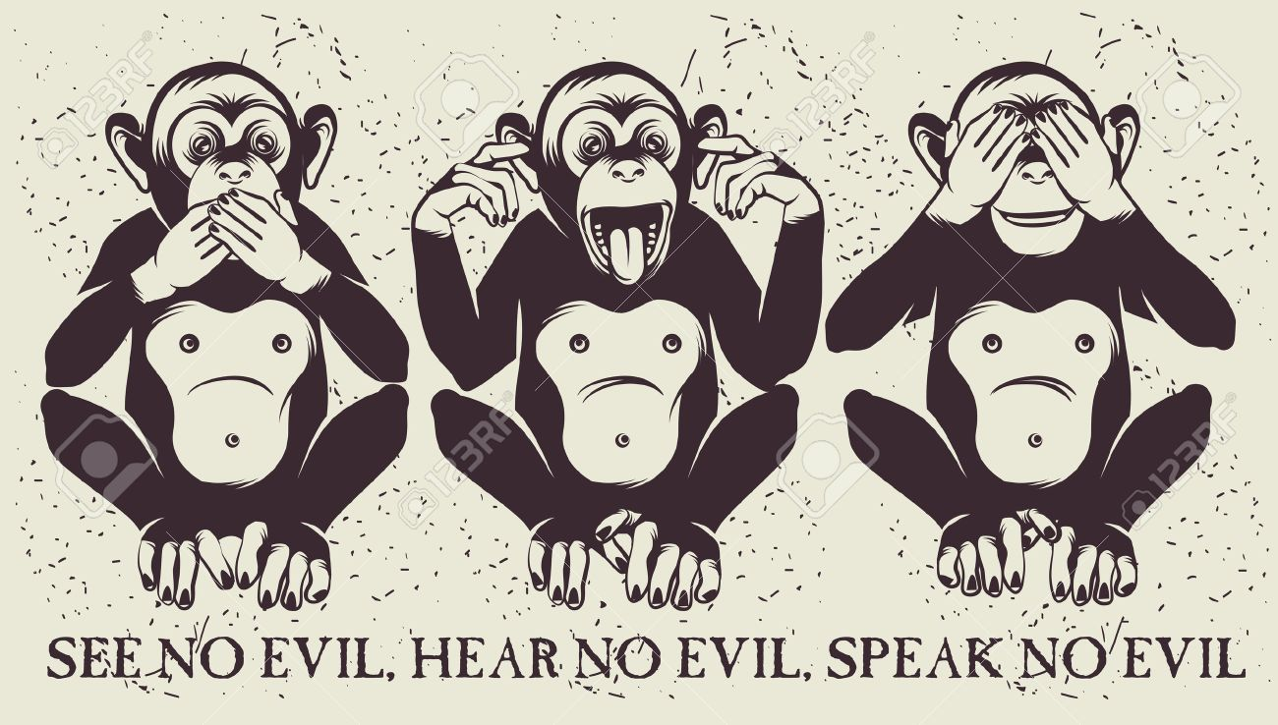
Critical theory
Human life = power struggle
→ Final truth about life
People don’t see the power dynamics in existing structures
Task of theory: criticize existing structures, power dynamics
→ Unspecific vision of “the good”, way forward

Slide 17
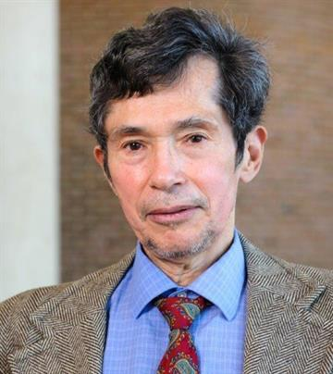
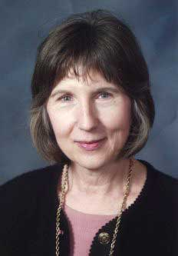
Critical race theory
Kimberlé Williams Crenshaw (Crenshaw et al., 1996)
© Felix Clay / eyevine
Richard Delgado
Jean Stefancic
(Delgado & Stefancic, 2017)
Notes:
K. Crenshaw: law professor at UCLA, Columbia
Delgado, Stefancic: U of Alabama law school

Slide 18
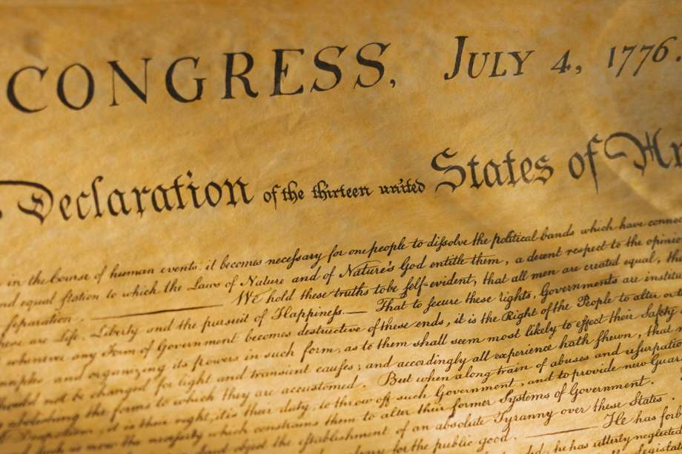
CT in CSD teaching: American history
1619 or 1776?
Critical theory: 1619

Slide 19
CT in CSD teaching: Code-switching
Code-switching: useful skill or perpetuation of oppression?
Critical theory: perpetuation of oppression

Slide 20
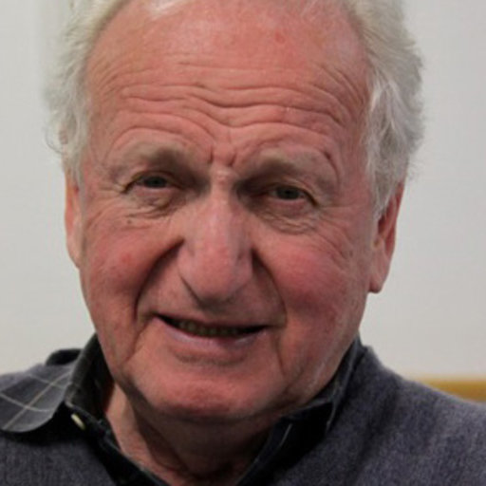
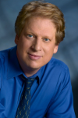
CT in CSD teaching: Othering and empathy
Empathy is crucial for clinical work (e.g. Luterman, 2016)
Empathy for “others” is not naturally part of the human condition (Bloom, 2014, 2016)

Slide 21
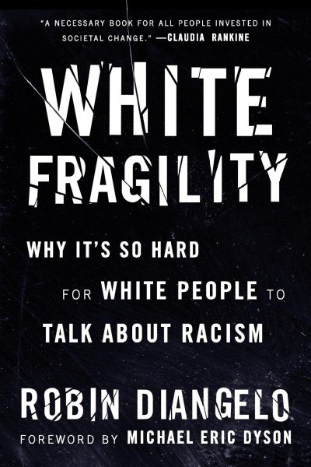
CT in CSD teaching: Othering and empathy
Critical theory: White people = beneficiaries, BIPOC people = victims of existing power structures—and that’s all there is
Unbridgeable gap between “us” and “them” → vicious cycle of othering (Berman, 2018; Goldberg; 2021; Lopez, 2016)
→ precludes empathy

Slide 22
3. Pragmatic humanism

Slide 23
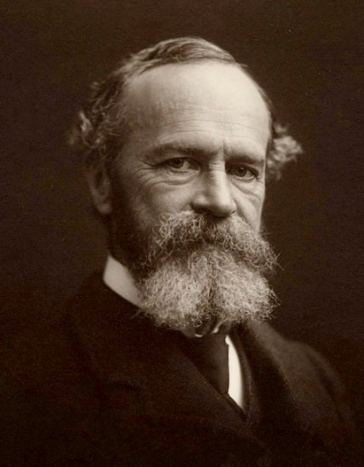
Pragmatic humanism
William James (1907)
F. C. S. Schiller (1903, 1907)
Concrete experience,
not abstract truth
Ana Honnacker (2018)

Slide 24
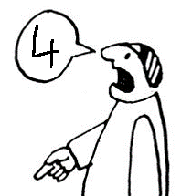
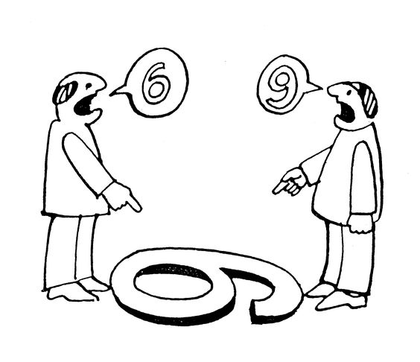
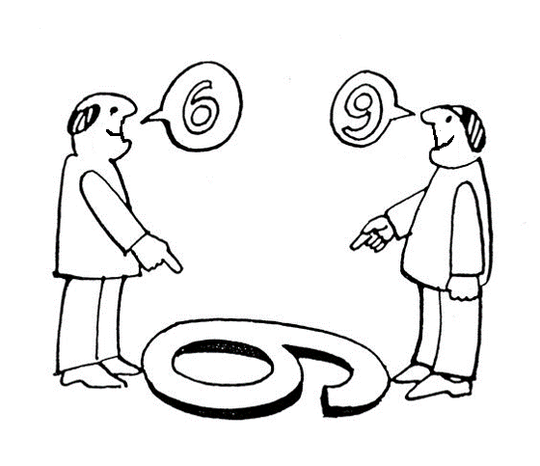
Pragmatic humanism
Human life = multiple conflicting realities
Knowledge: context-bound
Paradox, contradiction: normal
It’s not absolute truth that matters, but guidance for action
Vision of the good: human flourishing (within human limitations)

Slide 25
PH in CSD teaching: American history
American history: 1619 or 1776?
Pragmatic humanism: both
Notes:
This is not some lukewarm middle ground. The vision is clear: racism must be overcome. In this sense, PH and CT align (in fact, PH can USE CT as a tool). Difference: PH is very aware that the criticism of power imbalances doesn’t arise in a vacuum or because the proponents of the criticism have somehow superior, God-like vision. It is fueled by people’s values, and in this case, it’s America’s very own values that make racism unacceptable.

Slide 26
PH in CSD teaching: Code-switching
Pragmatic humanist answer: both
Work on SAE, value home dialect
Work through feelings of resistance, grief
Code-switching: useful skill or perpetuation of oppression?
© Getty Images/Creatas RF

Slide 27
PH in CSD teaching: Othering and empathy
Empathy for “others” is not naturally part of the human condition (Bloom, 2014, 2016)
Critical theory: danger of mutual otherizing of White, BIPOC people

Slide 28
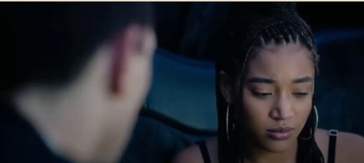
PH in CSD teaching: Othering and empathy
Critical theory reading: Chris discovers his White privilege
Pragmatic humanist reading:
Yes, discovery of White privilege; also:
Vulnerable disclosures
Struggle to see and to be seen
Finding common ground across different life-worlds
Building relationships, something new—together
Room for encounter → empathy → change

Slide 29
4. A Q&A with a Black educator & counselor

Slide 30
You endorse critical theory. Yet you say pragmatic humanism has value. Can you say more about that?

Slide 31
What are the struggles you have observed in White people grappling with racism?

Slide 32
What is your view of code-switching?

Slide 33
Thank you!—and feel free to reach out!

Slide 34
References
Adorno, T. W. (1951). Minima Moralia. Reflexionen aus dem beschädigten Leben [Minimal morals. Reflections from the damaged life]. Suhrkamp.
American Speech-Language-Hearing Association (n.d.). Cultural competence(Practice portal). www.asha.org/Practice-Portal/Professional-Issues/Cultural-Competence/
Berman, S. (2018). Why identity politics benefits the right more than the left. The Guardian. https://www.theguardian.com/commentisfree/2018/jul/14/identity-politics-right-left-trump-racism
Bloom, P. (2014). Just Babies: The Origins of Good and Evil. Broadway Books.
Bloom, P. (2016). Against empathy: the case for rational compassion. Vintage.
Crenshaw, K., Gotanda, N., Peller, G., & Thomas, K (1996). Critical race theory: The key writings that formed the movement. The New Press.
Delgado, R. & Stefancic, J. (2017). Critical race theory: An introduction. New York University Press.
Egede, L. E. (2006). Race, ethnicity, culture, and disparities in health care. Journal of General Internal Medicine, 21(6), 667–669. doi: 10.1111/j.1525-1497.2006.0512.x
French, D. (2020a, September 9). Why is so much diversity training radical and weird? The Dispatch. https://frenchpress.thedispatch.com/p/why-is-so-much-diversity-training
Goldberg, M. (2021). The Book That Should Change How Progressives Talk About Race. The New York Times. https://www.nytimes.com/2021/02/19/opinion/heather-mcghee-racism.html
Honnacker, A. (2018). Pragmatic humanism revisited: an essay on making the world a home. Palgrave Macmillan.

Slide 35
References
Horkheimer, M., & Adorno, T. W. (1947). Dialektik der Aufklärung: Philosophische Fragmente [Dialectics of enlightenment: Philosophical fragments]. Querido.
James, W. (1979/1907). Pragmatism. A new name for some old ways of thinking. The Works of William James Vol. 8. Harvard University Press .
Johnson, R. L., Roter, D., Powe, N. R., & Cooper, L. A. (2004). Patient race/ethnicity and quality of patient–physician communication during medical visits. American Journal of Public Health, 94(12), 2084–2090. https://doi.org/10.2105/ajph.94.12.2084
Johnson, R. L., Saha, S., Arbelaez, J. J., Beach, M. C., & Cooper, L. A. (2004). Racial and ethnic differences in patient perceptions of bias and cultural competence in health care. Journal of General Internal Medicine, 19(2), 101–110. https://doi.org/10.1111/j.1525-4801497.2004.30262.x
Lopez, G. (2016). Research says there are ways to reduce racial bias. Calling people racist isn't one of them. Vox. https://www.vox.com/identities/2016/11/15/13595508/racism-research-study-trump
Luterman, D. (2016). Counseling persons with communication disorders and their families. PRO-ED.
Robinson, G. C.,& Norton, P. C. (2019). A decade of disproportionality: A state-level analysis of African American students enrolled in the primary disability category of speech or language impairment. Language, Speech, and Hearing Services in Schools, 50, 267–282.
Schiller, F. C. S. (1903). Humanism. Philosophical Essays. Macmillan and Co.
Schiller, F. C. S. (1907). Studies in humanism. Macmillan and Co.
Shen, M. J., Peterson, E. B., Costas-Muñiz, R., Hernandez, M. H., Jewell, S. T., Matsoukas, K., & Bylund, C. L. (2018). The effects of race and racial concordance on patient-physician communication: A systematic review of the literature. Journal of Racial and Ethnic Health Disparities, 5(1), 117–140. https://doi.org/10.1007/s40615-017-0350-4

Slide 36
References
Spooner, K. K., Salemi, J. L., Salihu, H. M., & Zoorob, R. J. (2016). Disparities in perceived patient–provider communication quality in the United States: Trends and correlates. Patient Education and Counseling, 99(5), 844–854. https://doi.org/10.1016/j.pec.2015.12.007
Tervalon, M., & Murray-García, J. (1998). Cultural humility versus cultural competence: A critical distinction in defining physician training outcomes in multicultural education. Journal of Health Care for the Poor and Underserved, 9(2), 117–125. https://doi.org/10.1353/hpu.2010.0233

