Slide 1
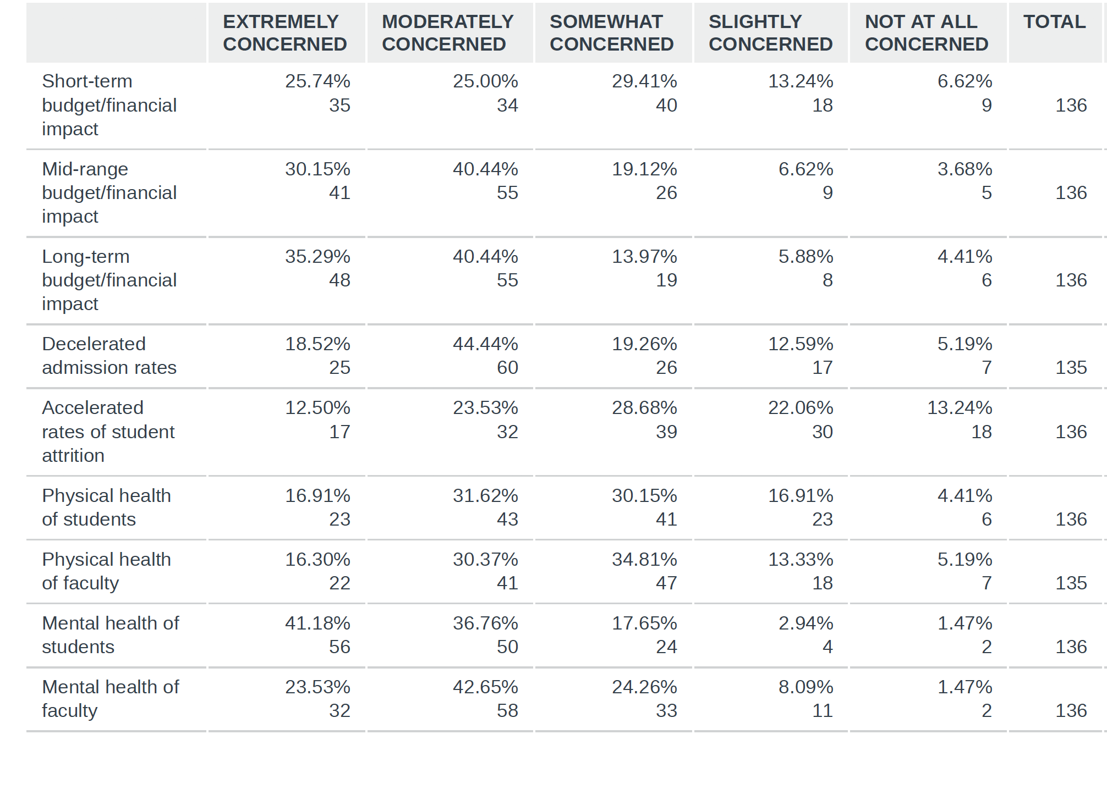
CAPCSD COVID IMPACT SURVEY
April 17, 2020
N= 136
WHAT WE ARE CONCERNED ABOUT

Slide 2
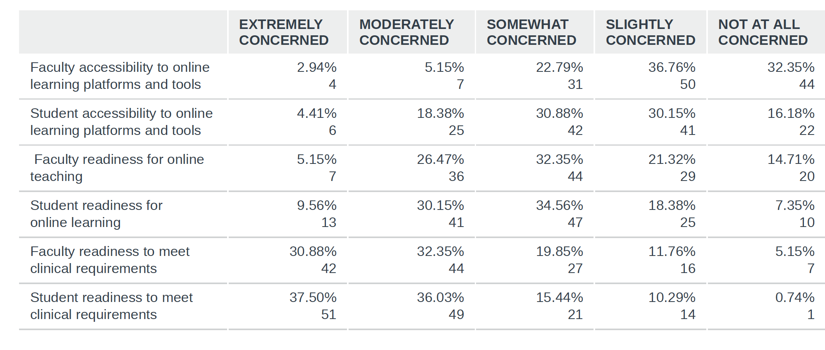
Accessibility and Readiness

Slide 3
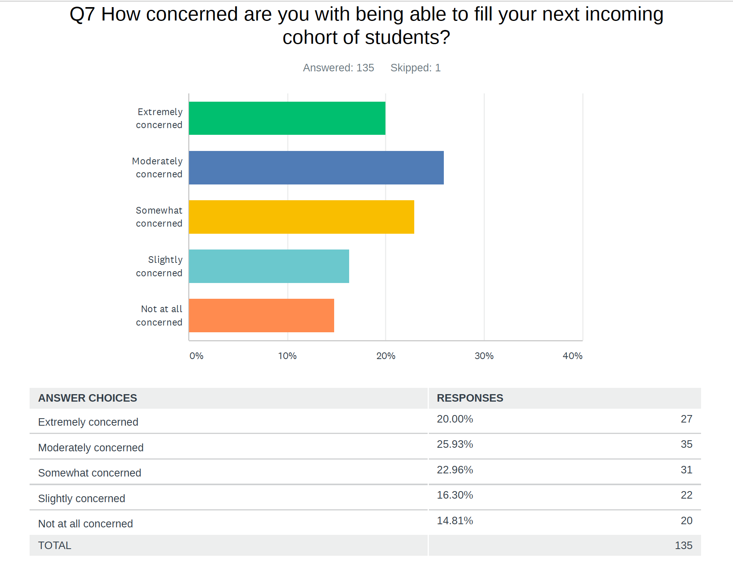
Admissions
  33% planning on making adjustments to admission process
  Extending deadlines, accept more students, incentivize admissions $, re-open application process, admit smaller cohort, don’t know

Slide 4
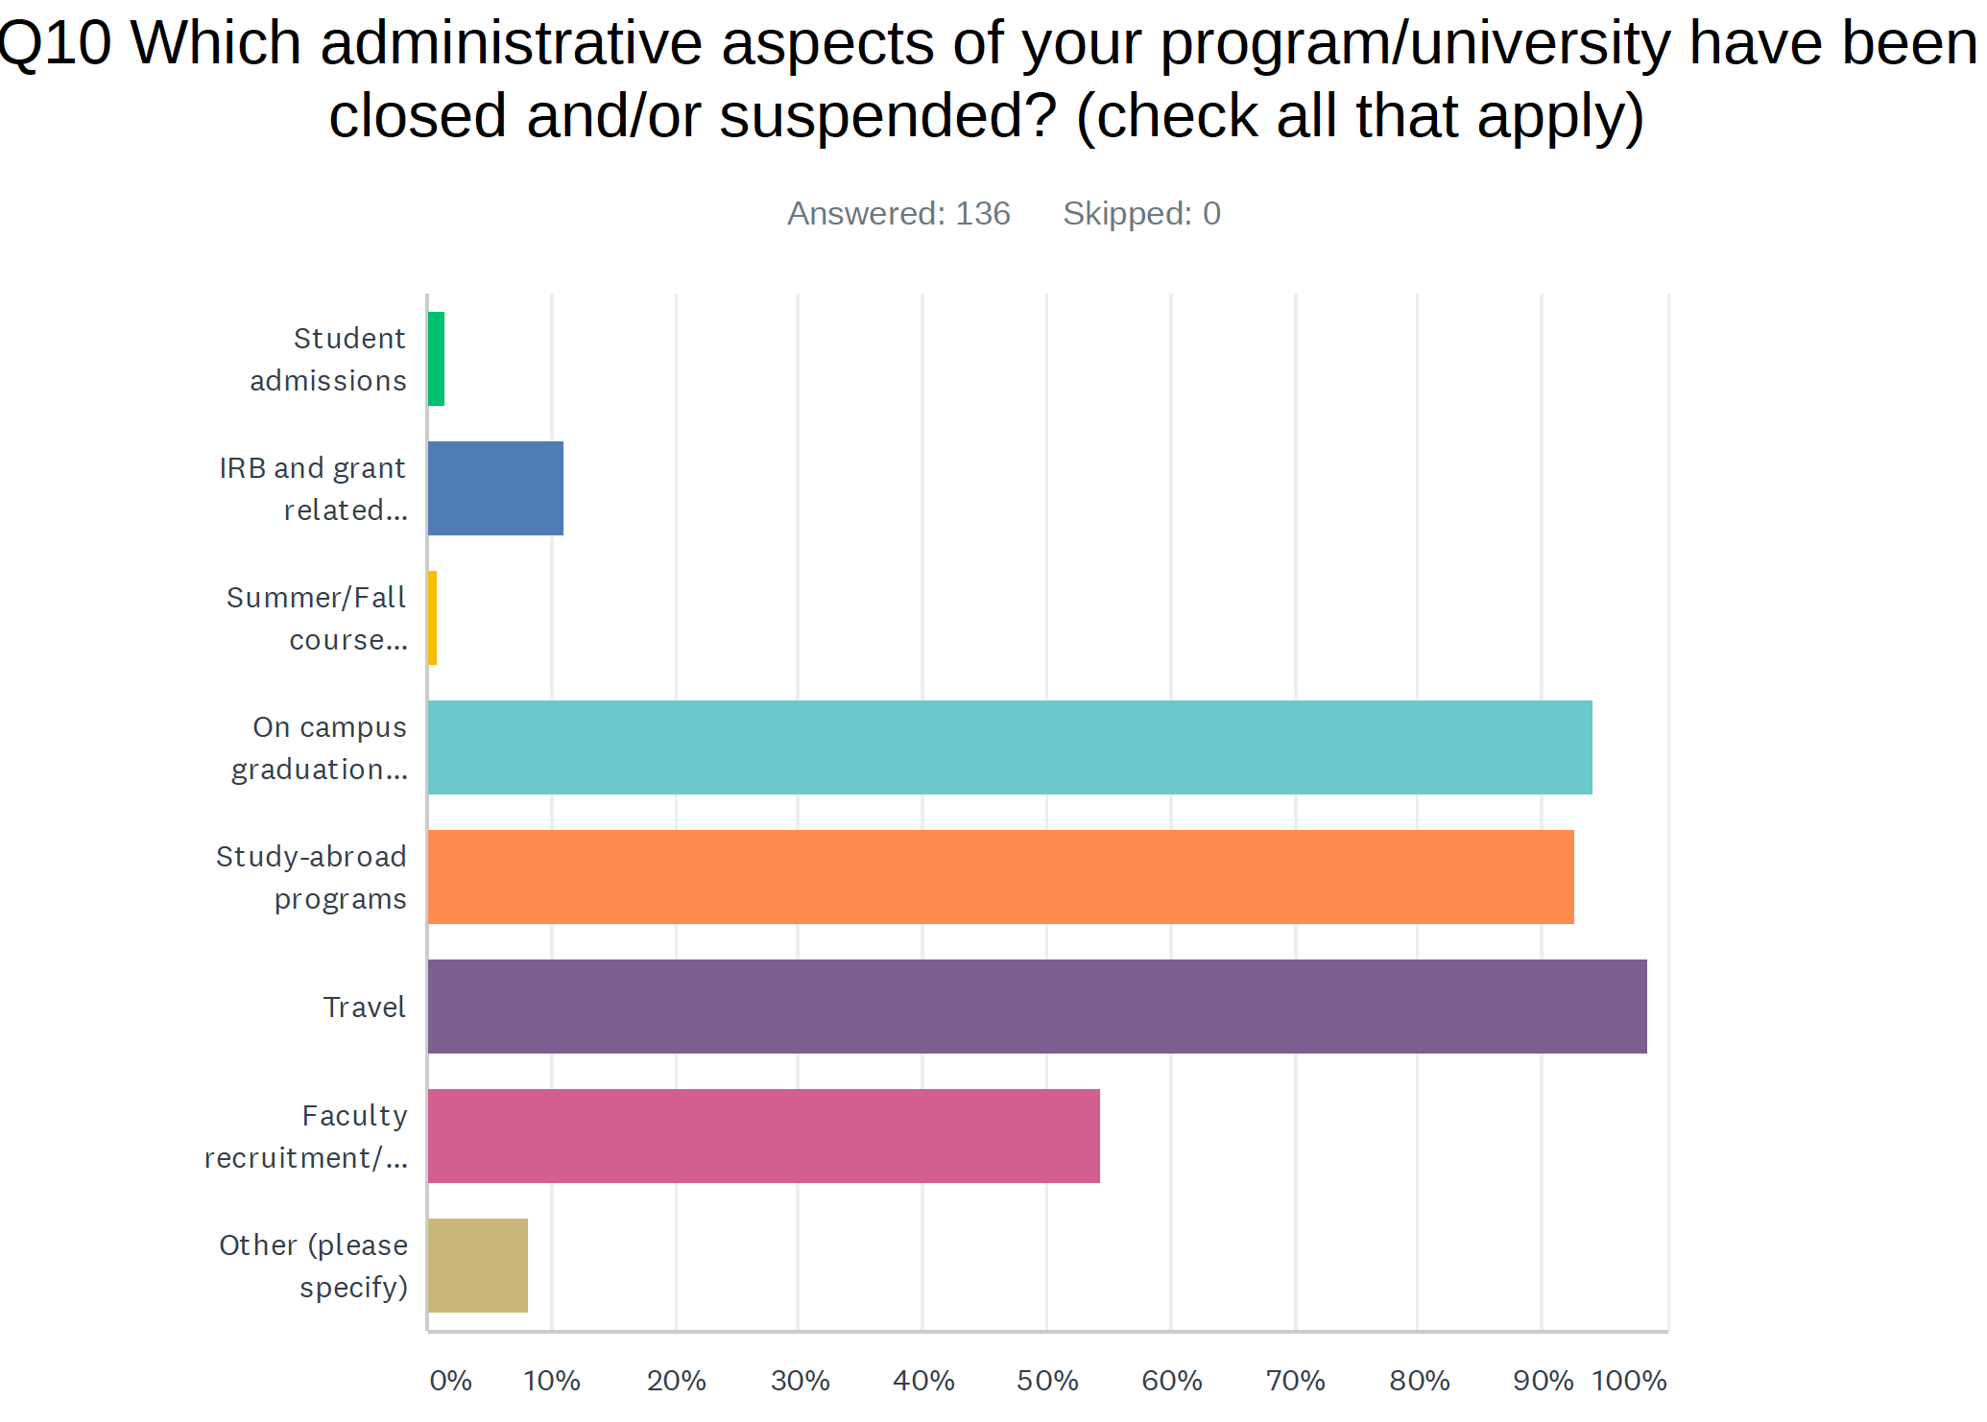
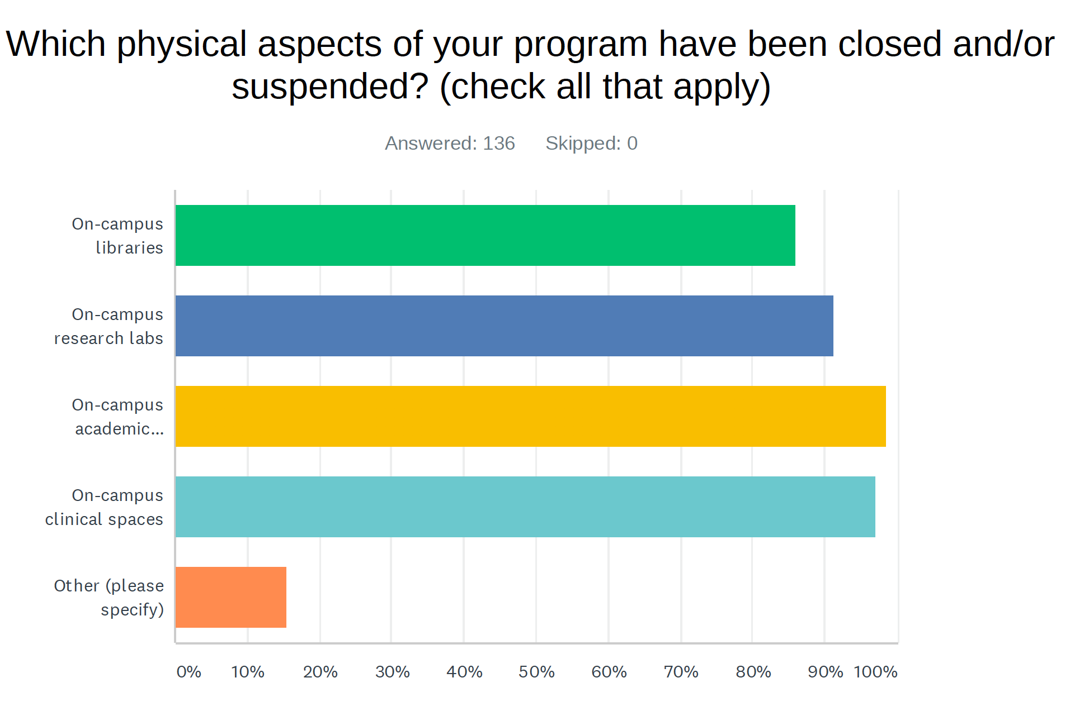
What’s closed or suspended

Slide 5
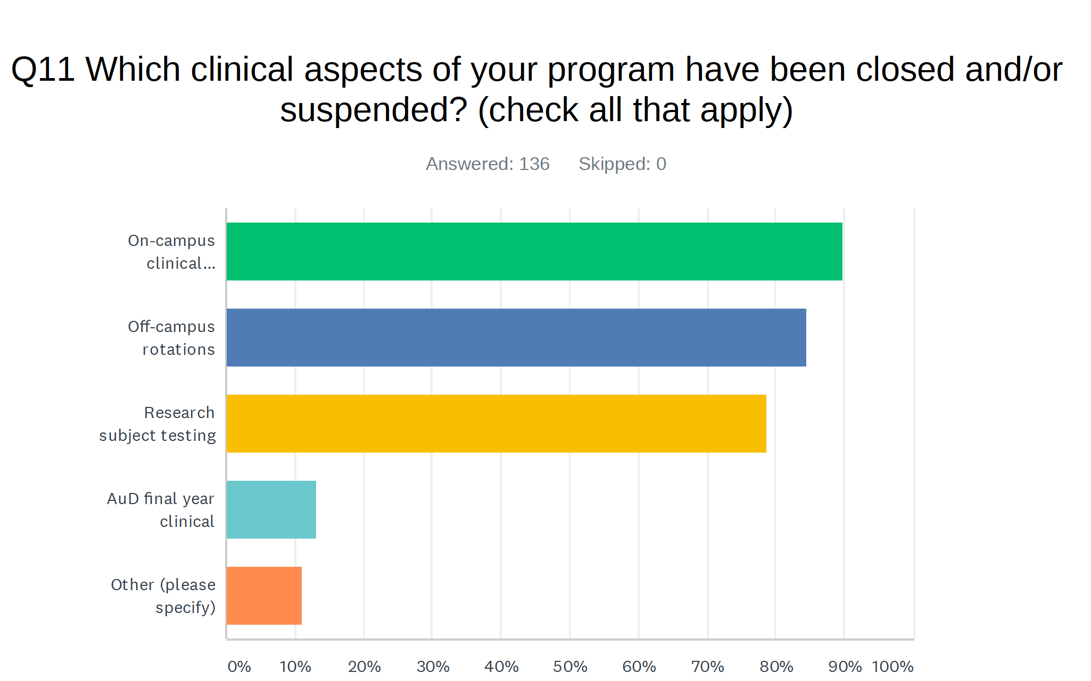
Clinical Aspects

Slide 6
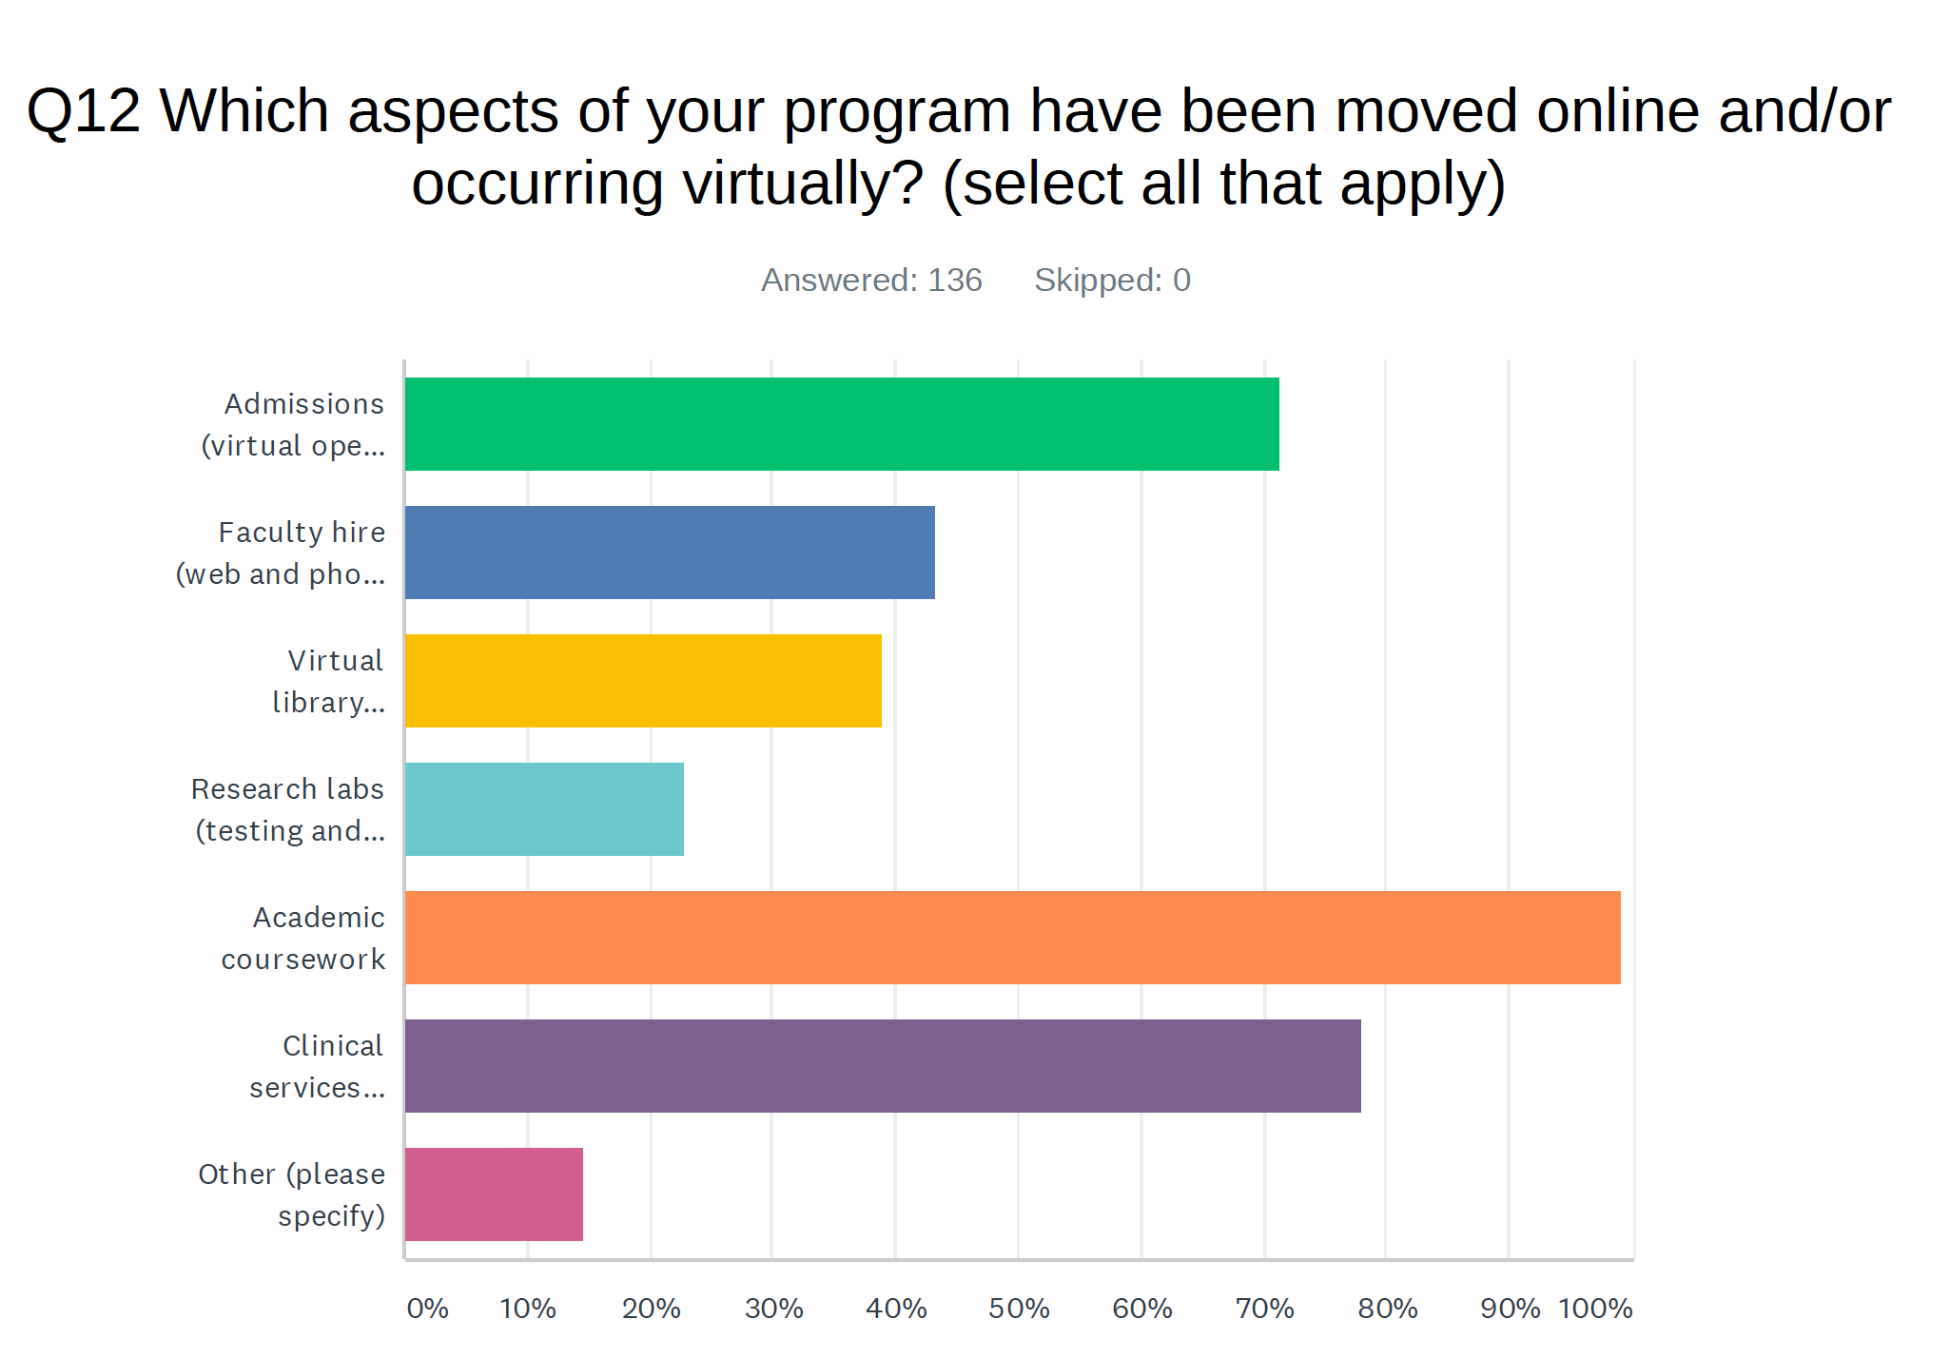
Moving Online

Slide 7
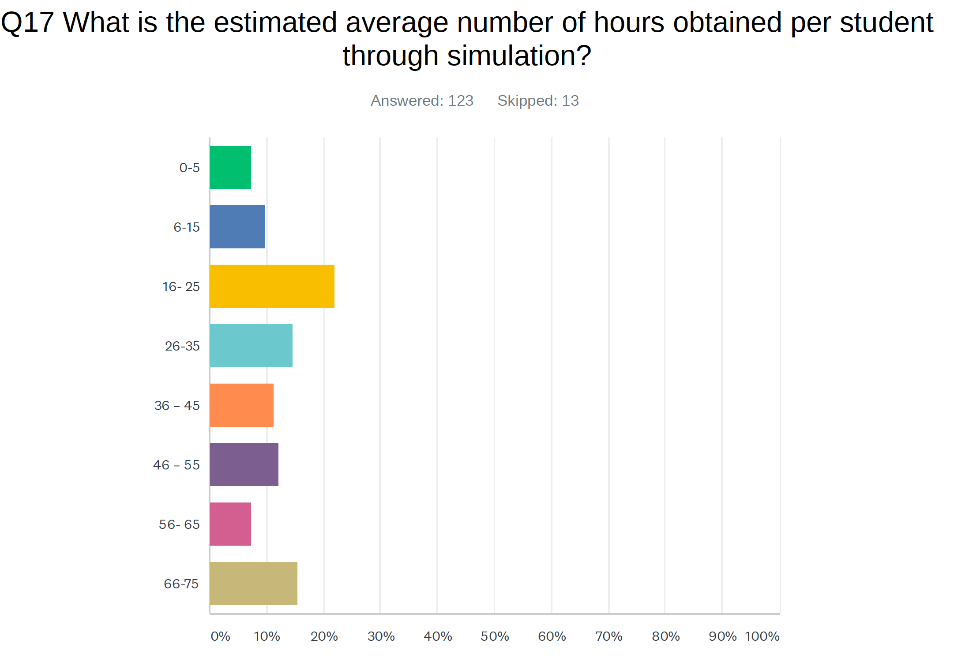
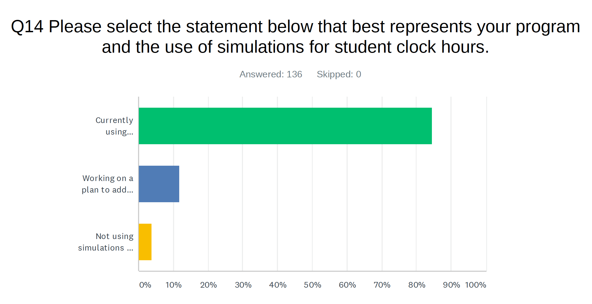
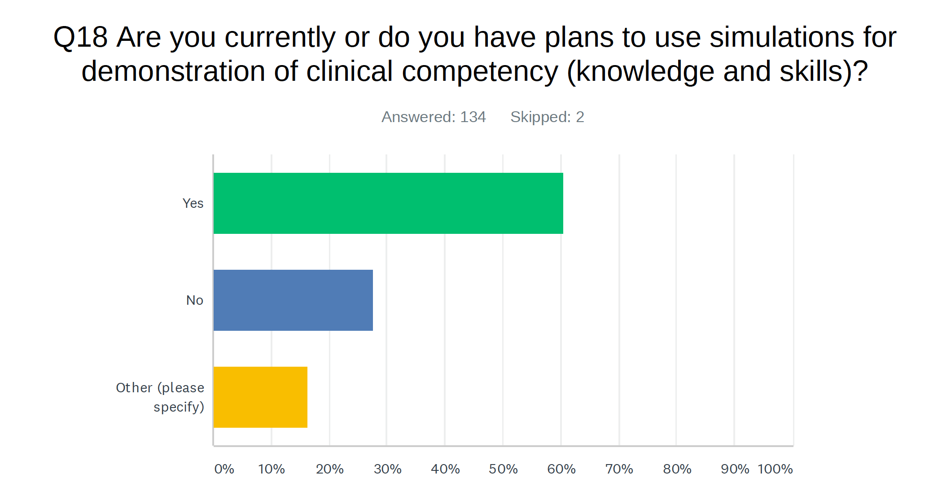
Simulations
Overwhelming using SIMUCASE
Conducting VIRTUAL DEBRIEFING

Slide 8
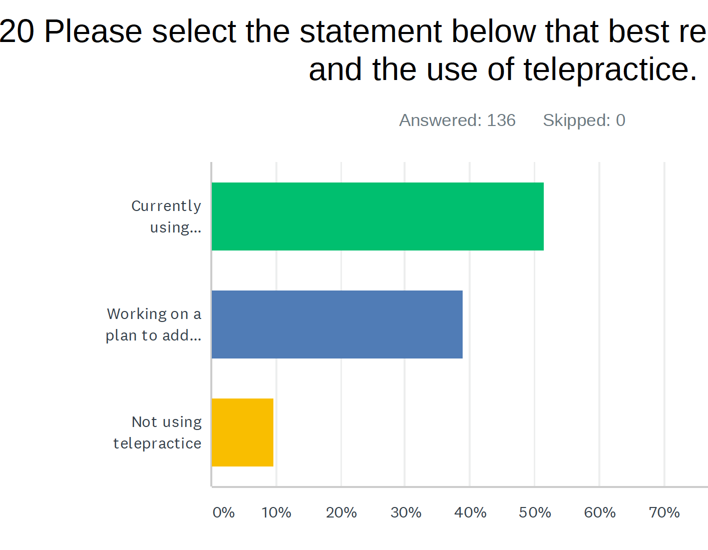
Telepractice
Platforms
--HiPPA compliant zoom
-- Webex
-- GoogleHangout
-- Microsoft Teams
85% HIPPA compliant
12% IDK
3% No

Slide 9
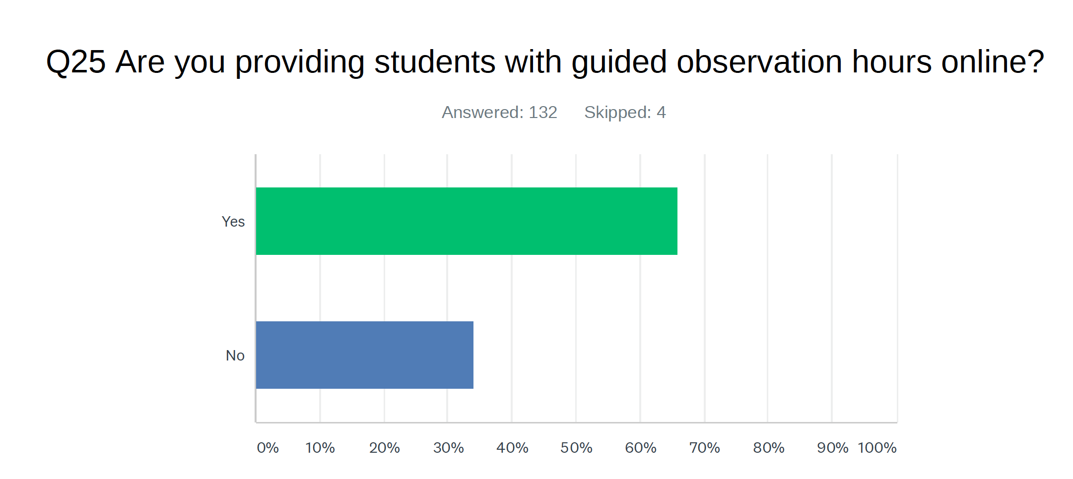
Guided Observation Hours
Master Clinician Network
Simucase
Youtube

Slide 10
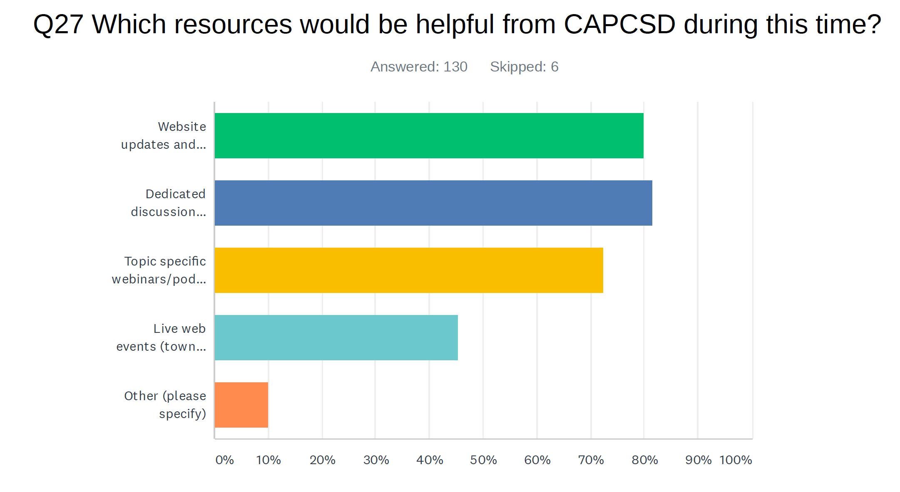
What can CAPCSD do to help
Topics of Importance
  Telehealth
  Student placements
  Student assessments
  Clinical clock hours
  What will it look like in the fall

